Slide 1
Electronics Systems (938II)
Lecture 4.2
Programmable Logic Devices – FPGA overview

Slide 2
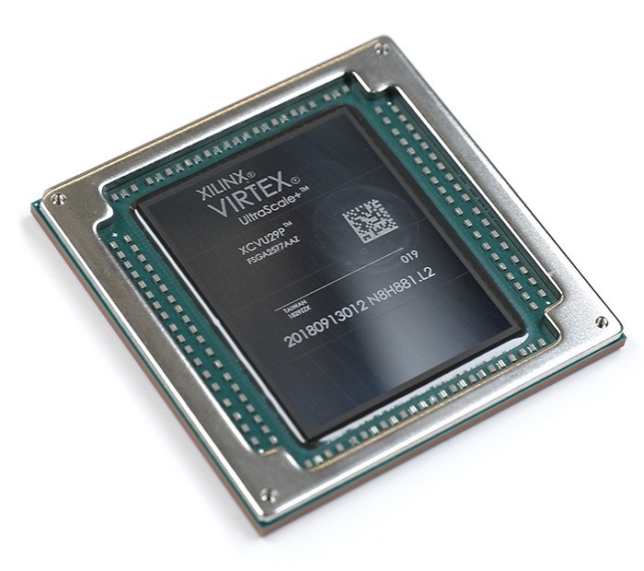
Introduction to FPGA*
PAL
CPLD
FPGA
Latest and most advanced PLD
FPGA = Field-Programmable Gate Array

Slide 3
Introduction to FPGA*
FPGAs are similar to PALs
Programmable device for implementing different logic functions at hardware level
The same piece of hardware, but different configurations → different circuits
Memory-like programming approach
OTP
Anti-fuses
Reprogrammable
SRAM-based

Slide 4
Introduction to FPGA*
How FPGAs are programmed
From computer through USB
Dedicated software
Each vendor use a different EDA software
Using latest HDLs
Verilog
VHDL
SystemVerilog

Slide 5
Introduction to FPGA*
However, FPGAs show some differences from PALs
Routing
Logic function block

Slide 6
Routing*
PAL
FPGA
Fixed routing wires
Programmable nodes
Non-segmented wires
Programmable routing wires
Segmented wires
Logic blocks

Slide 7
Routing*
Segmented routing in FPGAs
Higher flexibility
Higher wire delay
Can have an even greater impact on circuit speed (propagation delay) than the logic block

Slide 8
Routing*
Output of a logic block
Wire segments
…
…
…
…
Programmable connections
Input of a logic block

Slide 9










Routing*

Slide 10
Routing*
Programmable connections → R
Wire segments → C

Slide 11
Routing*
Programmable connections → R
Wire segments → C

Slide 12



Routing*

Slide 13



Routing*
Propagation delay of routing $∝$ (number of RC cells)²
Each RC cell introduces a delay

Slide 14
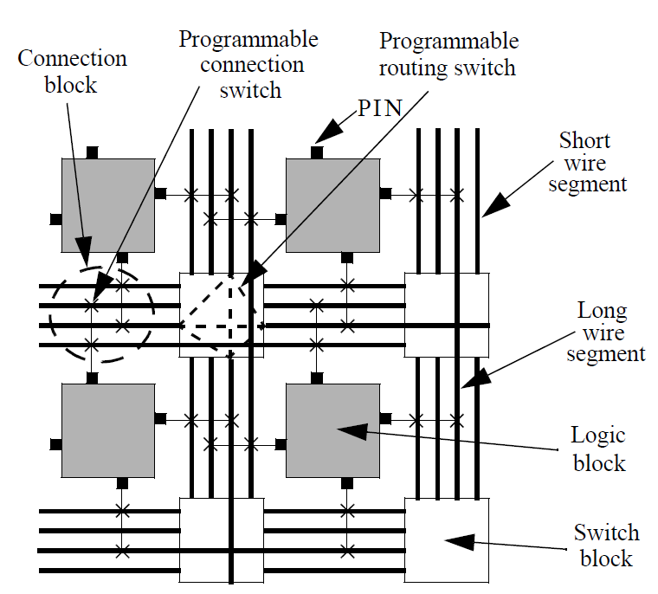
Routing*
Segmented routing in FPGA includes
Switching matrices
Local and global routing wires

Slide 15
Routing*
How programmable connections are realized?

Slide 16
Routing*
How programmable connections are realized?
Anti-fuse (OTP FPGA)
Anti-fuse symbol

Slide 17
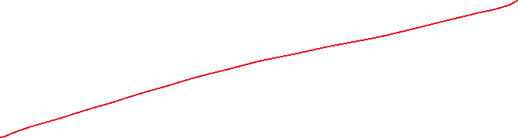
Routing*
How programmable connections are realized?
Anti-fuse (OTP FPGA)

Slide 18

Routing*
How programmable connections are realized?
Anti-fuse (OTP FPGA)
Default
(not programmed)
(open circuit)
Programmed
(short circuit)

Slide 19
Anti-fuse (in brief)*
Programming = application of a very high voltage (between two metal plates)
Non-conducting material
Metal
Metal
Default
(not programmed)
(open circuit)
Programmed
(short circuit)

Slide 20
Routing*
How programmable connections are realized?
SRAM (Reprogrammable FPGA)

Slide 21
Routing*
How programmable connections are realized?
SRAM (Reprogrammable FPGA)

Slide 22
Routing*
How programmable connections are realized?
SRAM (Reprogrammable FPGA)
Not connected
(open circuit)
Connected
(short circuit)

Slide 23
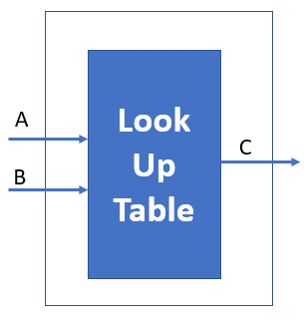
Logic function block*
PAL
FPGA
Fixed
AND planes + OR
Configurable
Based on Look-Up Table (LUT)

Slide 24
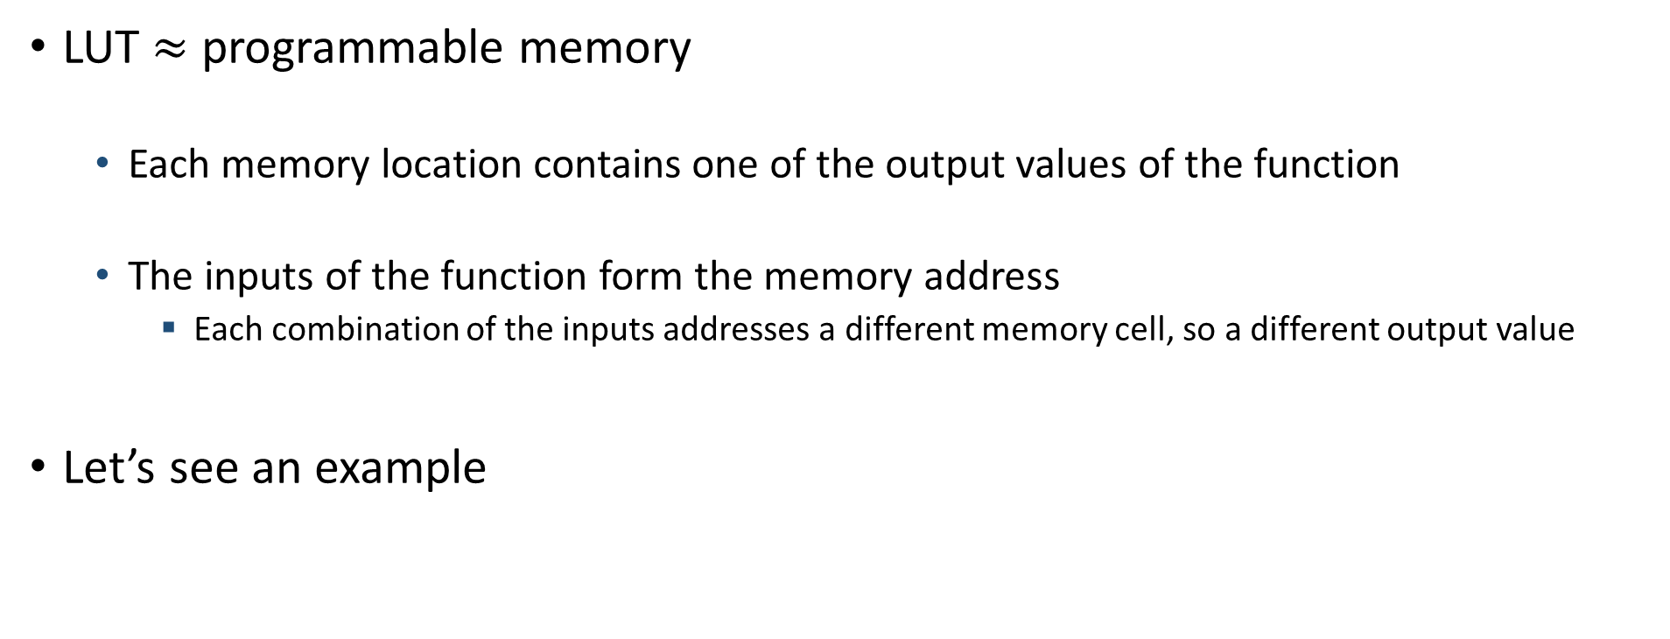
Logic function block*
LUT $≈$ programmable memory
Each memory location contains one of the output values of the function
The inputs of the function form the memory address
Each combination of the inputs addresses a different memory cell, so a different output value
Let’s see an example

Slide 25
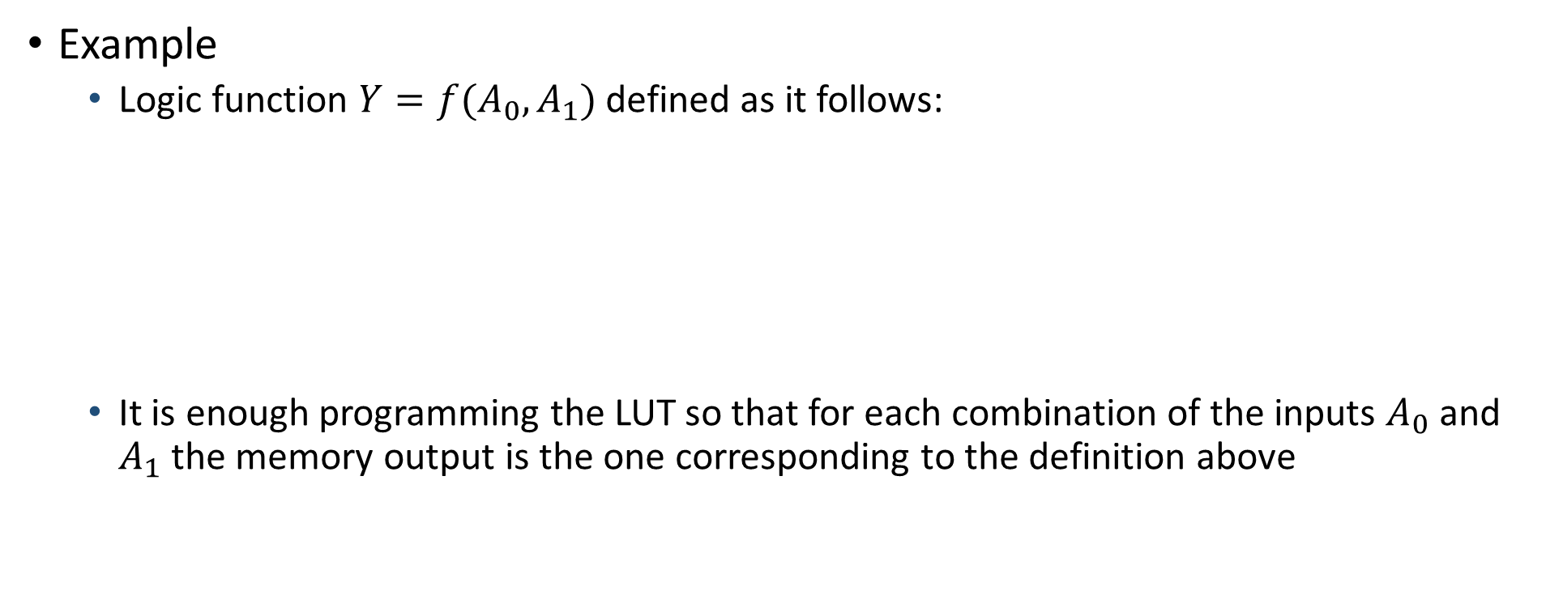
Logic function block*
Example
Logic function $Y=f(A_{0},A_{1})$ defined as it follows:
It is enough programming the LUT so that for each combination of the inputs $A_{0}$ and $A_{1}$ the memory output is the one corresponding to the definition above

Slide 26

Logic function block*
LUT
Rationale
$Y=f(A_{0},A_{1})$ defined as it follows:
Decoding logic

Slide 27



Logic function block*
LUT
Rationale
$Y=f(A_{0},A_{1})$ defined as it follows:
Decoding logic

Slide 28


Logic function block*
LUT
Rationale
$Y=f(A_{0},A_{1})$ defined as it follows:
Decoding logic

Slide 29


Logic function block*
LUT
Rationale
$Y=f(A_{0},A_{1})$ defined as it follows:
Decoding logic

Slide 30


Logic function block*
LUT
Rationale
$Y=f(A_{0},A_{1})$ defined as it follows:
Decoding logic

Slide 31
Logic function block*
LUT
How is a LUT made?
Decoding logic

Slide 32
Logic function block*
LUT architecture outline

Slide 33

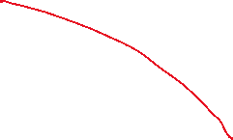
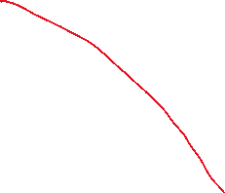




Logic function block*
LUT architecture outline

Slide 34


Logic function block*
LUT architecture outline

Slide 35








Logic function block*
LUT architecture outline
Example: $Y_{2}=f(A_{0},A_{1})$

Slide 36










Logic function block*
LUT architecture outline
Example: $Y_{2}=f(A_{0},A_{1})$

Slide 37










Logic function block*
LUT architecture outline
Example: $Y_{2}=f(A_{0},A_{1})$

Slide 38












Logic function block*
LUT architecture outline
Example: $Y_{2}=f(A_{0},A_{1})$

Slide 39










Logic function block*
LUT architecture outline
Example: $Y_{2}=f(A_{0},A_{1})$

Slide 40
Logic function block*
How are memory cells realized?

Slide 41

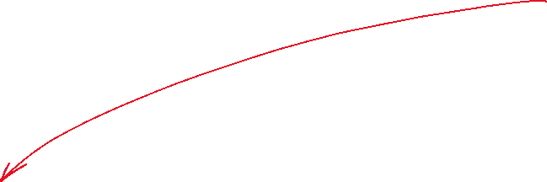
Logic function block*
How are memory cells realized?
Anti-fuse (OTP FPGA)

Slide 42




Logic function block*
How are memory cells realized?
Anti-fuse (OTP FPGA)
Default
(not programmed)
Programmed
(short circuit)

Slide 43
Logic function block*
How are memory cells realized?
SRAM (Reprogrammable FPGA)

Slide 44
Logic function block*
How are memory cells realized?
SRAM (Reprogrammable FPGA)

Slide 45
Logic function block*
The one in this example can called 2–LUT
2 inputs
Earliest FPGAs were equipped with 3–LUTs
Modern FPGAs are equipped with 6–LUTs

Slide 46
Logic function block*
Architecture outline
Inputs
Clock

Slide 47
Logic function block*
FPGA
PAL
AND plane 1
Inputs
AND plane 2
AND plane 3
Clock
Inputs
Clock

Slide 48
CLB*
The logic function block also embeds other resources to improve flexibility and performance
The overall block is called Configurable Logic Block (CLB)
It assumes different names based on the FPGA vendor
Altera/Intel
ALM = Adaptive Logic Module
Xilinx/AMD
CLB = Configurable Logic Block
Slice (in older FPGAs)
Microsemi/Microchip
LE = Logic Elements

Slide 49
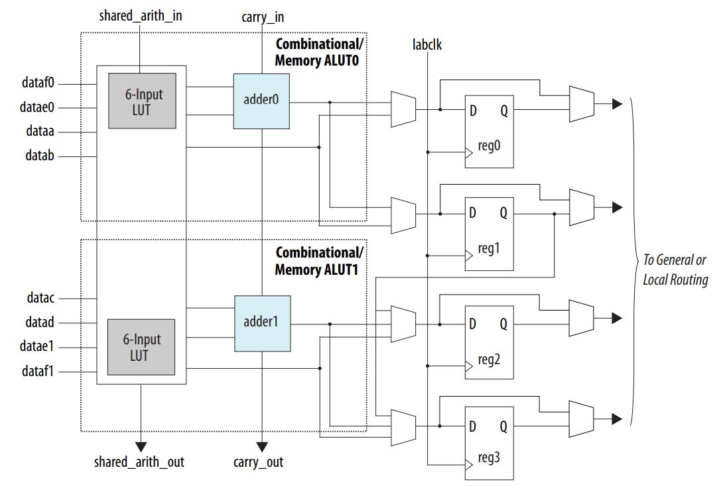
CLB – Example
ALM
Altera/Intel
Cyclone V FPGA

Slide 50
Architecture outline*
Finally, we can see the overall architecture of an FPGA
Organized in regions
Region
I/O banks
Global routing

Slide 51
Architecture outline*
Finally, we can see the overall architecture of an FPGA

Slide 52
Architecture outline*
Finally, we can see the overall architecture of an FPGA
IOB : Input/Output Block
RAM : RAM memory block
DSP : Digital Signal Processor
____ : local routing
____ : global routing

Slide 53
Architecture outline*
Latest FPGAs can embed also a processor
Processor typically called HPS = Hard Processing Systems
Usually ARM processor
The overall device typically called FPGA SoC
SoC = System-on-Chip
I/O banks reserved for HPS

Slide 54
Anti-fuse vs. SRAM*
Anti-Fuse FPGA
SRAM FPGA
OTP (One-Time Programmable)
Permanent programming
Do not need to be re-programmed after power-on
Robust against disturbances
E.g.: radiations → suitable for space applications
It is not possible to test before the release
Can be re-programmed
Volatile programming
Need to be re-programmed after power-on
Low resistance against disturbances
Electromagnetic disturb may change a SRAM bit, modifying the configuration and the functionality
Possibility to test before the release

Slide 55
Are FPGA really used in modern applications?*
Yes! For different reasons and/or a combination of them
Flexibility
Time-to-market
Costs

Slide 56
Are FPGA really used in modern applications?*
Yes! For different reasons and/or a combination of them
Flexibility
Time-to-market
Costs
Possibility to re-program (SRAM FPGA) without changing/substituting the HW
Bug fixing
System update

Slide 57
Are FPGA really used in modern applications?*
Yes! For different reasons and/or a combination of them
Flexibility
Time-to-market
Costs
Shorter time from being conceived until being available for sale
3–6 Months vs. 3–5 years (typical time-to-market for ICs)

Slide 58
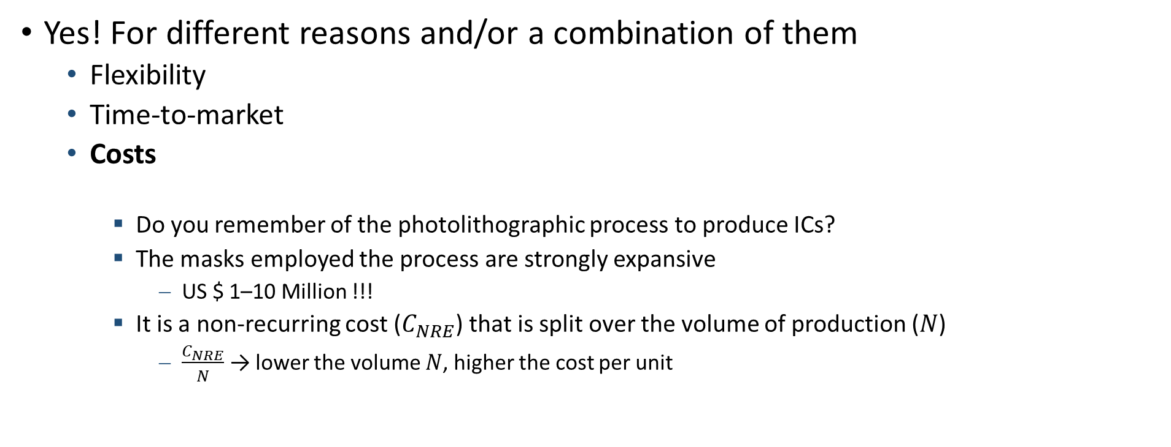
Are FPGA really used in modern applications?*
Yes! For different reasons and/or a combination of them
Flexibility
Time-to-market
Costs
Do you remember of the photolithographic process to produce ICs?
The masks employed the process are strongly expansive
US $ 1–10 Million !!!
It is a non-recurring cost ($C_{NRE}$) that is split over the volume of production ($N$)
$\frac{C_{NRE}}{N}$ → lower the volume $N$, higher the cost per unit

Slide 59

FPGA vs. IC – Cost vs. Volume of production*
Assume
$C_{NRE}$ = Non-recurring costs
$C_{RE}$ = Recurring costs per unit
$C_{RE_{IC}}≪C_{RE_{FPGA}}$
$C_{TOT}$ = Total cost per unit
$N$ = number of units
It follows that
$C_{TOT_{FPGA}}$ = $C_{RE_{FPGA}}$
$C_{TOT_{IC}}$ = $C_{RE_{IC}}$ + $\frac{C_{NRE}}{N}$

Slide 60
FPGA – Last notes
Main vendors – EDA and main devices
Altera/Intel
EDA : Quartus Prime
Main FPGA families : Cyclone, Arria, Stratix
Xilinx/AMD
EDA : Vivado
Main FPGA families : Spartan, Kintex, Artix, Virtex
Microsemi/Microchip
EDA : Libero SoC
Main FPGA families : PolarFire, SmartFusion, RT (Radiation Tolerant)

